Slide 1


BumbleBee: Enabling the Vision of Pervasive ZigBee Backscatter Communication
Zhaoyuan Xu and Wei Gong
University of Science and Technology of China
Notes:
Hello, everyone! My name is zhaoyuan xu and I come from the University of Science and Technology of China. Today I would like to present our work entitled “BumbleBee: Enabling the Vision of Pervasive ZigBee Backscatter Communication”.

Slide 2

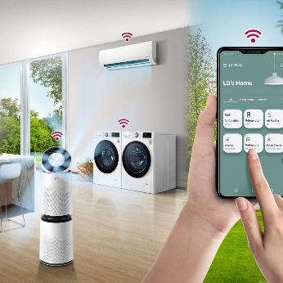




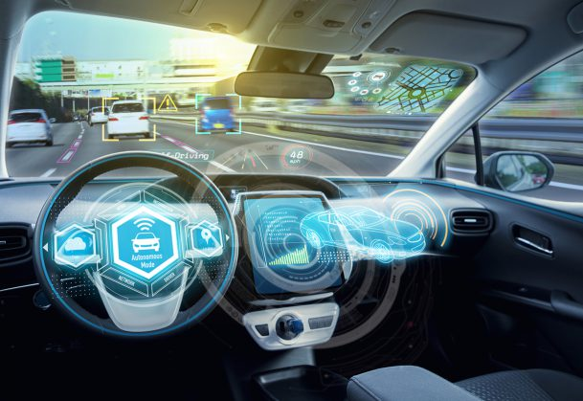
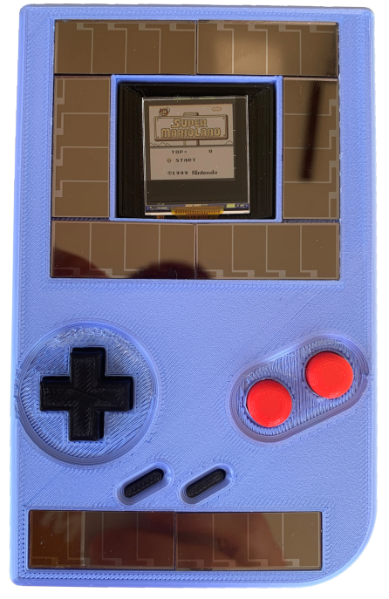



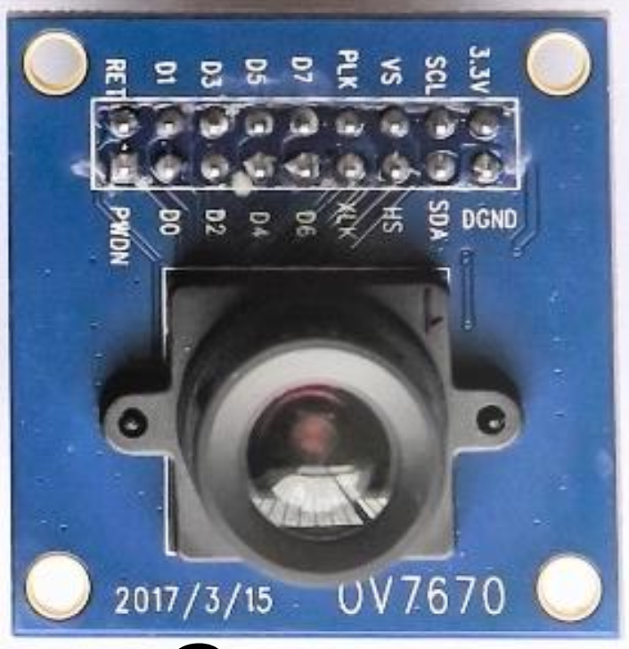
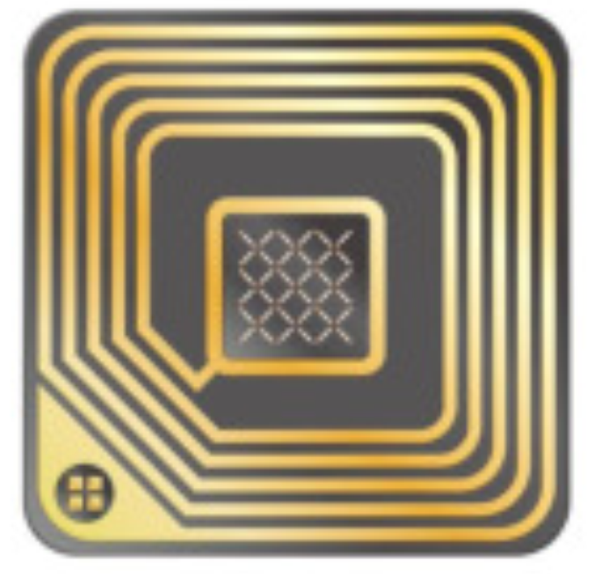

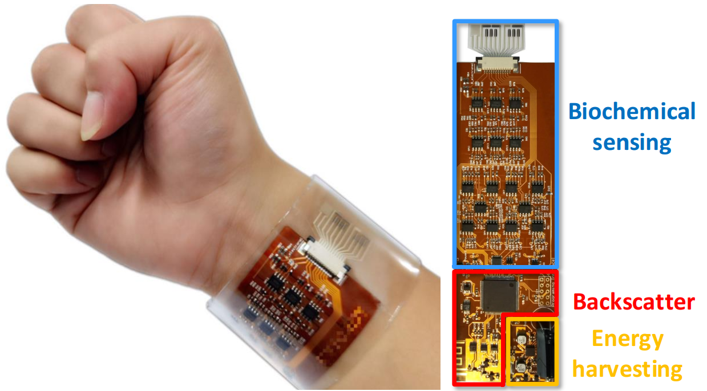

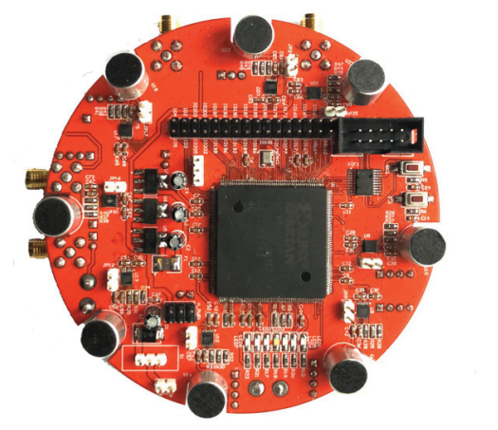

Backscatter Enables Pervasive Connectivity
Smart Home
Healthcare
Smart City
Environment
Logistics
Autopilot
Reader
ZigBee Backscatter Tag
Notes:
In recent years, backscatter communication has emerged as an ultra-low power alternative for active radios. It enables pervasive connectivity for lots of IoT applications, including smart homes, healthcare, smart city, and so on. For example, in our home, backscatter cameras, wearables, and game boys collaborate to make the room intelligent and comfortable. All of them are connected and interact with neighbor readers. From conventional RFID technology to the latest ZigBee backscatter radios, the system is getting through a tremendous revolution. It gets rid of bulky and expensive RFID readers and struggles to use existing electronics for excitors as far as possible. Deploying with little cost and compatible with existing radios, ZigBee backscatter has a greatly extended coverage and is an excellent candidate for the vision of pervasive connectivity.

Slide 3
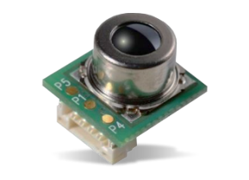
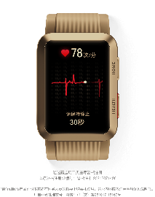

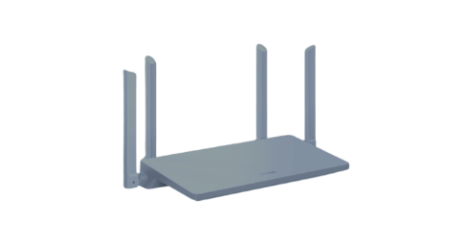
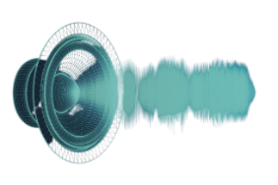
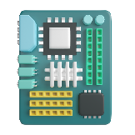
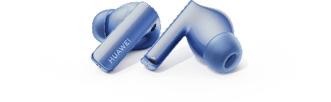
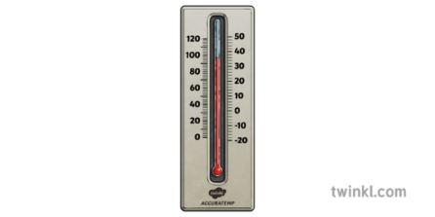

ZigBee Backscatter Primer
RF carrier
Backscattered signal
Reflect
Absorb
ZigBee backscatter tag
Commodity transceivers
Notes:
A ZigBee backscatter system consists of backscatter tags and commodity transceivers. The tag is able to collect images, sound, and temperature from the environment. Instead of producing power-expensive RF signals locally, it piggybacks data over ambient RF carriers by switching the impedance state. That’s what we called backscatter. Commodity radios, such as earphones, routers, and smartwatches, can be used for carrier generation and backscattered signals’ reception. However, since ambient RF carriers are out-of-control, advanced backscatter systems have several drawbacks that prevent them from being deployed in practice. Researchers tradeoff between the carrier constriction and the receiver complexity.

Slide 4


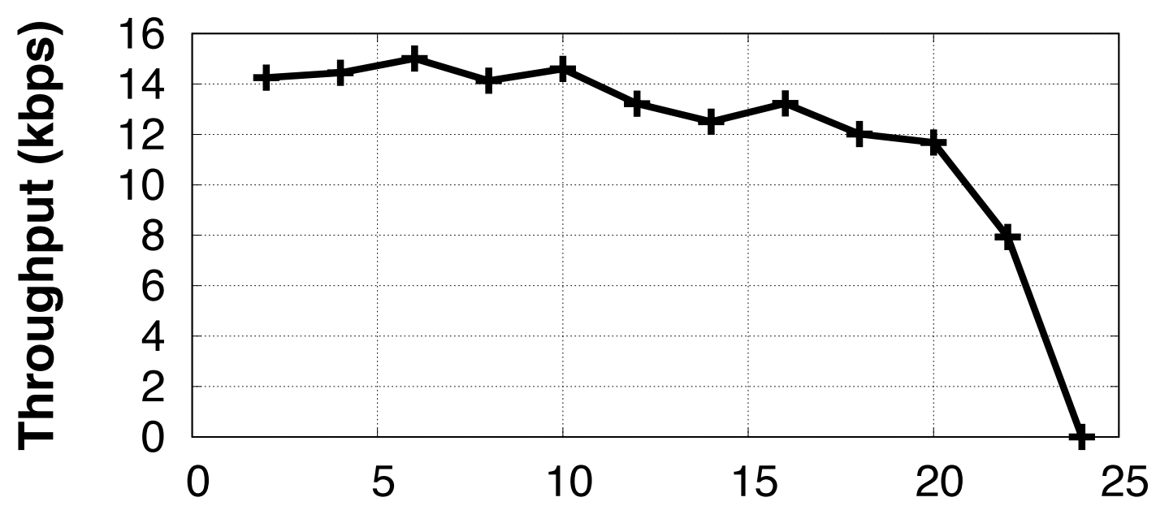











Advanced ZigBee Backscatter Systems
1. Redundant Receiver
Receiver 1
$$…$$
$$…$$
$$1$$
$$0$$
$$…$$
$$…$$
$$0$$
$$1$$
$$…$$
$$…$$
Excitor
Constriction: Receiver and Tag Throughput.
Tag
Receiver 2
$$N$$
$$N$$
Codeword translation
FreeRider CoNEXT’ 17
Multiscatter CoNEXT’ 20
2. Redundant Coding
Notes:
Codeword translation is a well-known technology, which transforms multiple codewords present in the original excitation signal into other valid codewords from the same codebook during backscattering. Although it is free to the excitor, there are two constrictions. Firstly, since the excitation symbols used as reference are unknown to the demodulator, it requires one redundant receiver compared to active communication. Secondly, the throughput is dramatically decreased from 250 kbps to 16 kbps due to the redundant coding. In all, the system has constrictions on the receiver complexity and tag throughput.

Slide 5

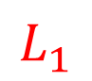
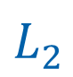


Advanced ZigBee Backscatter Systems
$$L_{0}$$
$$L_{1}$$
2. Low Carrier Utilization
$$L_{2}$$
$$L_{1}$$
Preamble
Access Address
PDU
CRC
0x55
4 Bytes
0x0000…
3 Bytes
SHR
PHR
PDU
Constriction: Excitor and Tag Throughput.
Tag
Excitor
Single-Tone
Receiver
Non-Single-Tone
1. Specific Single-tone Excitor
Single-tone excitation
Interscatter SIGCOMM’ 16
ZigBee Backscatter ICNP’ 22
Notes:
Other systems use single-tone excitation to create standards-compliant ZigBee packets. Ambient signals are transformed into single-frequency tones. The tag skips the non-single-tone header and uses the single-tone payload to backscatter ZigBee. The systems have several drawbacks. Firstly, the excitation is specified and unable to transmit data productively. Secondly, the tag can only use single-tone for excitation and thus the carrier utilization is greatly limited. In a word, the system is limited to the excitor and tag throughput.

Slide 6
Can we build a pervasive ZigBee backscatter system without any constriction?
Notes:
After reviewing the limitation of prior work, we ask a question: can we build a pervasive ZigBee backscatter system without any constriction?

Slide 7

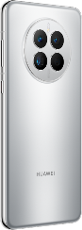
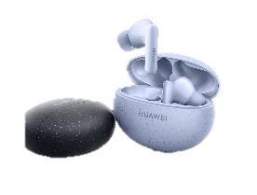
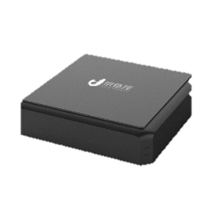
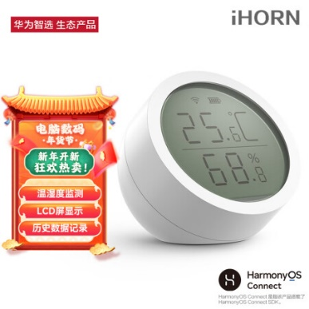
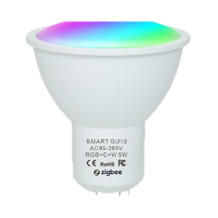
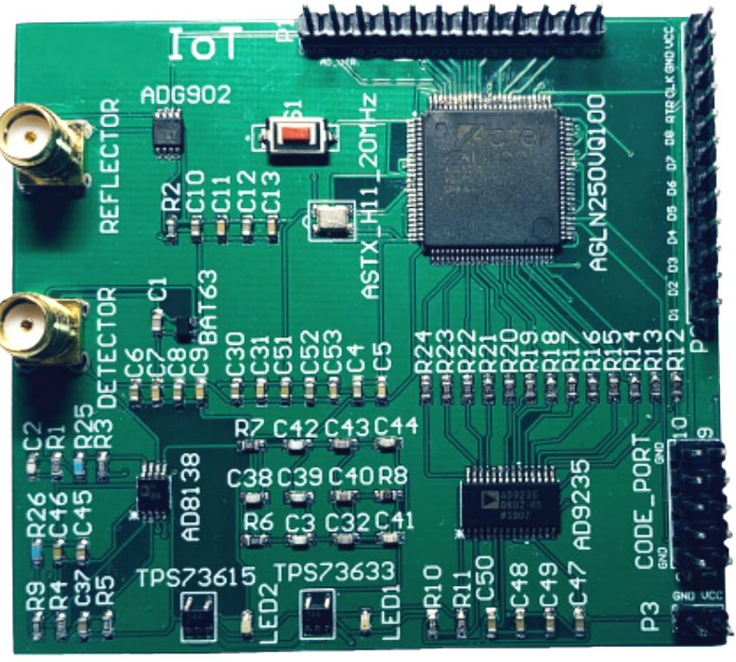
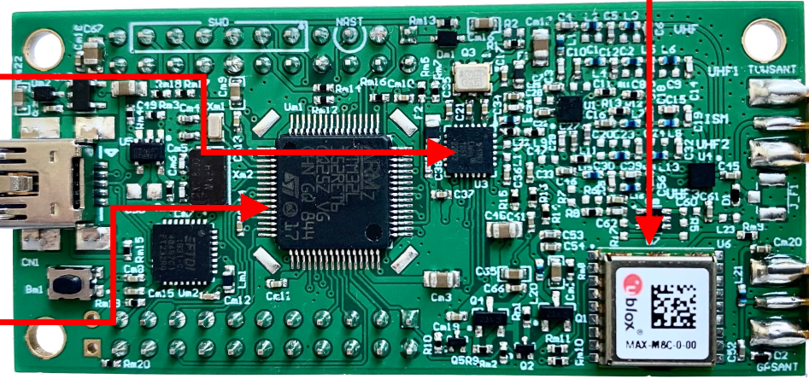
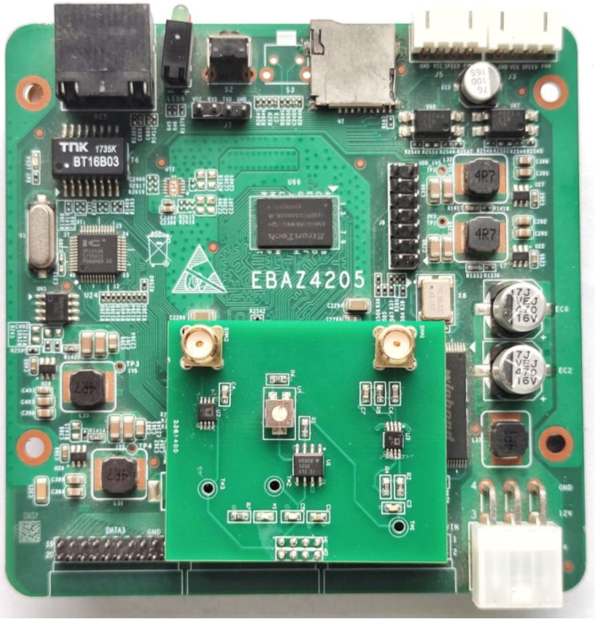
Requirement Analysis
Excitor
Tag
Receiver
Pervasive
Commercial
Non-specific
Throughput: 250 kbps.
Carrier utilization: 100%
One receiver
Commercial
Productive BLE
Standards-compliant packet
Commodity ZigBee
Notes:
We give a detailed analysis of our requirements. In terms of excitor, it must be pervasive in our life, commercially available, and not specifically designed. Phones, headsets, and laptops are expected to be excitors. Since all of the above electronics support BLE transmission, productive BLE can be an excellent candidate to excite our tag. Further, the carrier utilization and throughput can be up to 100% and 250 kbps, which is the boundary of active radios. It requires our tag to produce standards-compliant packets. Besides, one commercial receiver will be sufficient for the tag data demodulation.

Slide 8
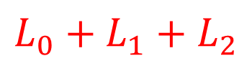
System Overview
2. High Carrier Utilization
$$L_{0}$$
$$L_{1}$$
$$L_{2}$$
$$L_{0}+L_{1}+L_{2}$$
Preamble
Access Address
PDU
CRC
0x55
4 Bytes
N bytes
3 Bytes
SHR
PHR
PDU
Tag
Excitor
Receiver
Non-Single-Tone
1. Productive BLE Excitor
3. One commodity ZigBee Receiver
Notes:
We present BumbleBee, a novel backscatter system that creates ZigBee transmissions over productive BLE. It has three properties that differ from prior work. Firstly, arbitrary BLE over the air can be backscattered directly. The systems’ coverage is greatly extended. Secondly, since the tag doesn’t skip the non-single-tones, the utilization can be up to 100% and the throughput is corresponding improved. Finally, only one commodity ZigBee receiver is required for the reception of backscattered signals. In a word, none of the excitor, throughput, or receivers are limited.

Slide 9
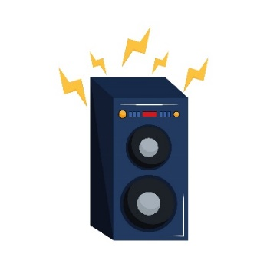
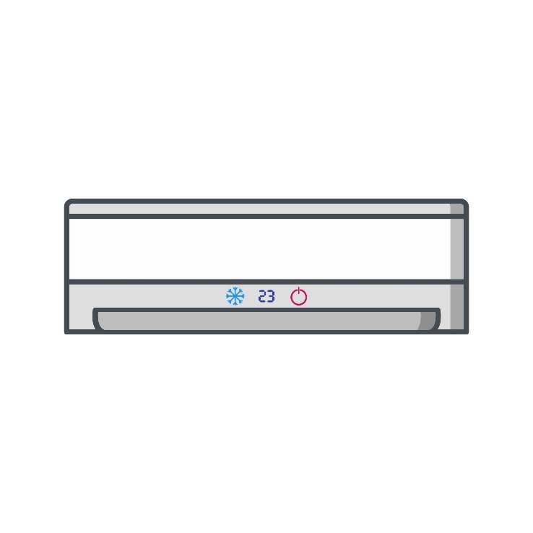








Future
Notes:
The application of BumbleBee is pervasive in our life. Connections of smartphones, headsets, and smart speakers are ready for BumbleBee excitors. The tag collects and piggybacks data, including instructions and indicators of our body, over ambient BLE. People will be pleased with BumbleBee because they can get tag data while listening, calling, or transmitting files.

Slide 10
Challenges
Data Rate | 1 Mbps | 250 Kbps
Direct Sequence Spread Spectrum(DSSS) | No | 2 Mchip/s
Channel Bandwidth | 2 MHz | 5 MHz
Modulation | GFSK | OQPSK
No theoretical or experimental support!
Notes:
The implementation of BumbleBee is challenging since BLE and ZigBee have different physical layer specifications. BLE reaches a bitrate cap of 1 Mbps and adopts GFSK modulation. ZigBee supports 250 kbps and takes both OQPSK and Direct Sequence Spread Spectrum for content modulation. The transformation from productive BLE to ZigBee has no theoretical or experimental support.

Slide 11
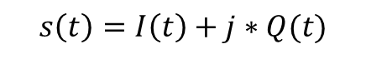
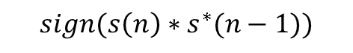
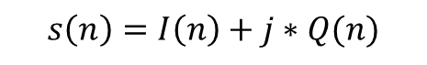
Inspiration
$$s\left(n\right)=I\left(n\right)+j∗Q(n)$$
Down Converter
IF Channel Filter
Quadrature Demodulator
ADC
$$s\left(t\right)=I\left(t\right)+j∗Q(t)$$
$$sign(s\left(n\right)∗s^{∗}(n−1))$$
0
++------++…
…
+
1
+--+++----…
…
$$phase(s\left(n\right)∗s^{∗}\left(n−1\right))∈(0, π]$$
Correlator
Data bits
-
14
---+----+-…
$$phase(s\left(n\right)∗s^{∗}\left(n−1\right))∈(−π, 0]$$
15
++++---+--…
32
Is it sufficient to produce a dominant phase shift?
Notes:
Our inspiration comes from the commodity ZigBee receiver, whose core design is a quadrature demodulator. It detects the filtered phase shift sequence in every ZigBee chip unit. If the phase shift is calculated within zero to pi, it is denoted as positive and vice versa as negative. Further, the sequence is correlated with the predefined symbol sequence. Thus, we are wondering: if we can modulate dominant tag data over ambient carriers, we do not need to constrain the carrier content, and thus it is promising to build a productive backscatter system.

Slide 12

Key Idea
Q
Q
BLE phase shift
Demodulated as ‘1’
I
I
Demodulated as ‘0’
1. The phase shift of ambient BLE is negligible within each ZigBee chip unit.
2. Our tag is able to produce a dominant phase shift.
Notes:
The key idea of BumbleBee is shown in the constellation. The phase shift of productive BLE within the ZigBee chip unit is negligible. Since ZigBee receivers use a quadrature demodulator for the phase content demodulation, the backscattered signal is demodulated to `1' when the tag data is positive half a pi and `0' when it comes to negative half a pi. Along this line, we will first observe the phase shift of BLE within the ZigBee chip unit. After that, we will show the BumbleBee tag design and demonstrate that our tag is able to produce a dominant phase shift.

Slide 13
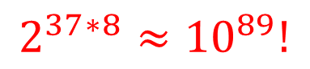



BLE Phase Shift
1M SPS
+250 kHz, -250 kHz,
-250 kHz, +250 kHz…
13M SPS
1,0,0,1…
Bits
BFSK
Gaussian Filter
$$∆f(n)$$
$$φ(n)$$
$$φ(t)$$
Digital Integrator
DAC
Up Convertor
Preamble
Access Address
PDU
CRC
0x55
4 Bytes
2~258 Bytes
3 Bytes
$$2^{37∗8}≈{10}^{89}!$$
It is impossible to traverse all BLE packets!
Notes:
The generation of BLE is shown in the figure. A BFSK module takes the bitstream as input. It assigns bit `1' to a frequency deviation of +250 kHz and bit `0' to -250 kHz. A Gaussian Filter pulse shapes an input frequency into a specific waveform. To completely obtain an overview of the BLE phase shift, an intuitive approach is to traverse all BLE packets and obtain their distribution. Such an experiment is easy to design but difficult to deploy in practice. Specifically, a BLE advertising packet supports a payload length of 37 bytes, which corresponds to over ${10}^{89}$possibilities. This is greatly beyond our estimation. To reduce the complexity, we are wondering if we can determine the BLE phase shift by some representative patterns.

Slide 14
BLE Phase Shift
1/0
1/0
1/0
1 2 …
1 2 … 19 20
… 19 20
Sampling index
The output is overlapped by consecutive bits.
Representative BLE patterns are used to analyze the BLE phase shift.
Notes:
Fortunately, the output of Gaussian Filter is overlapped by consecutive BLE impulse response. The previous and successive Gaussian pulses can affect the instantaneous pulses concurrently. Thus, BLE packets are split into eight different patterns. We are able to identify the phase shifts by observing these representative patterns. Specifically, the phase shift in the second bit is representative to observe since it can only be overlapped by the first and third bits.

Slide 15
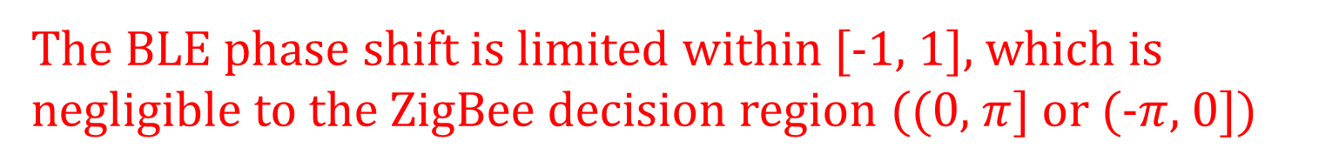
BLE Phase Shift
111
110
101
100
000
001
010
001
The BLE phase shift is limited within [-1, 1], which is negligible to the ZigBee decision region ((0, $π$] or (-$π$, 0])
Notes:
We measure the phase shift distribution over the second bit for different BLE patterns. Pattern `000' and `111' concentrate around positive or negative quarter of pi. Other patterns attain a tradeoff between `111' and `000'. Their median concentration will either fall below that of `000', nor exceed `111' and the specific distribution is determined by neighbor BLE pulses. Since every BLE packet consists of representative patterns and all of them are concentrated within [-1, 1], it is easy to identify that the phase shift of ambient BLE is also concentrated within [-1, 1].

Slide 16
BLE Phase Shift
Random BLE phase shift is also limited within [-1, 1].
Notes:
To confirm the conclusion, we also count the phase shift of random BLE. Most of them are distributed between [-1, 1].

Slide 17
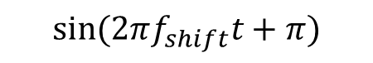
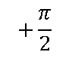
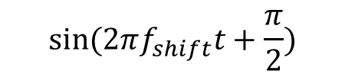
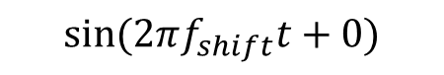
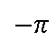
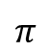
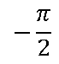
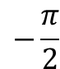

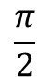
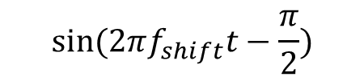
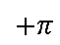
IPS Modulation
Q
$$sin⁡(2πf_{shift}t+\frac{π}{2})$$
$$\frac{π}{2}$$
$$sin⁡(2πf_{shift}t+0)$$
$$π$$
0
I
$$−\frac{π}{2}$$
$$sin⁡(2πf_{shift}t+π)$$
$$sin⁡(2πf_{shift}t−\frac{π}{2})$$
$$+π$$
Frequency harmonics!
$$+\frac{π}{2}$$
$$0$$
$$−\frac{π}{2}$$
$$−π$$
Notes:
In terms of the tag modulation, conventional backscatter tags take instantaneous phase shift modulation. It takes four square waves to modulate different phases respectively. However, IPS modulation produces frequency harmonics in the frequency domain, which can not be deployed practically.

Slide 18
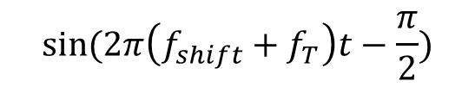
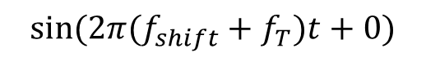
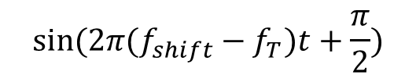
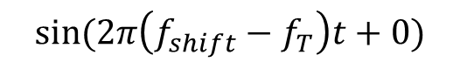
FPS Modulation
Q
$$sin⁡(2π(f_{shift}−f_{T})t+\frac{π}{2})$$
$$\frac{π}{2}$$
$$sin⁡(2π(f_{shift}+f_{T})t+0)$$
$$π$$
0
I
$$sin⁡(2π\left(f_{shift}+f_{T}\right)t−\frac{π}{2})$$
$$−\frac{π}{2}$$
$$sin⁡(2π\left(f_{shift}−f_{T}\right)t+0)$$
$$+π$$
No frequency harmonics!
$$+\frac{π}{2}$$
$$0$$
$$−\frac{π}{2}$$
$$−π$$
Notes:
Instead, our tag takes frequency-phase modulation, which uses an additional frequency shift to accumulate phase shift. Thus, the spectrum efficiency is greatly improved.

Slide 19
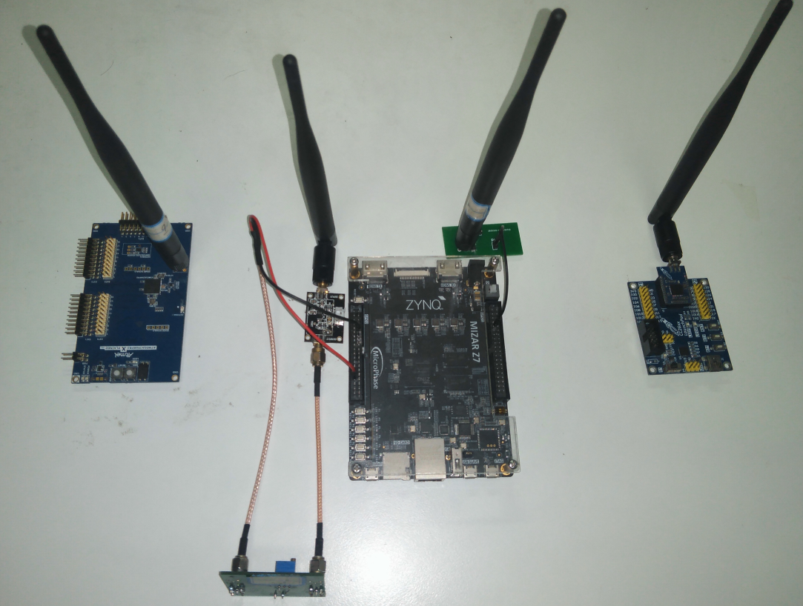
Implementation
Tag prototype:
Envelope detector: AD8313+Comparator
RF switch: ADG902
Processor: FPGA (ZYNQ7000)
Commodity BLE transmitter: TI CC2640R2F, CC1352, CC2540, CC2650
Commodity ZigBee receiver: TI CC2650, CC2530
Notes:
The prototype of BumbleBee consists of an envelope detector, and RF switch and an FPGA processor. The excitor and receiver is evaluated with multiple commodity radios.

Slide 20
Evaluation
218 kbps
40 kbps
4.7 kbps
The throughput of BumbleBee is 3x over Interscatter and 32x over FreeRider
Notes:
We evaluate the throughput and bit error ratio with different systems. The throughput of BumbleBee, Interscatter, and FreeRider is 218 kbps, 40 kbps, and 4.7 kbps, respectively. The bit error ratio of BumbleBee and Interscatter are close to each other, which demonstrates that productive BLE does little interference on the backscattered product. In a word, the evaluation show that The throughput of BumbleBee is 3x over Interscatter and 32x over FreeRider.

Slide 21
Evaluation
Commodity radio
Interscatter
BumbleBee
The spectrum efficiency of BumbleBee is 3.1x
higher than that of Interscatter
Notes:
We evaluate the spectrum occupation with different systems. The spectrum occupation of Interscatter is 5.7 MHz and BumbleBee has a spectrum occupation of 1.8 MHz. The spectrum efficiency of BumbleBee is 3.1x higher than that of Interscatter. Detailed analysis can be seen in our paper.

Slide 22
Evaluation
BumbleBee
Minimum throughput: 179 kbps
Interscatter
Maximum throughput: 82 kbps
BumbleBee works universally with commodity transceivers.
Notes:
We use multiple pairs of commodity transceivers to evaluate the system’s effectiveness. In the figure, the x label indicates different BLE transmitters. And the y label is the corresponding throughput. The evaluation shows that the minimum throughput of BumbleBee is 179 kbps, whereas the maximum throughput of Interscatter is 82 kbps. The experiment demonstrates that BumbleBee works universally with commodity transceivers.

Slide 23
Conclusion
We provide an insightful observation that productive BLE, which is pervasive in our lives, is a qualified RF carrier for ambient ZigBee backscatter.
We propose BumbleBee, a novel ambient backscatter system that overwrites dominant tag data on ambient BLE.
We build a prototype of BumbleBee and validate its effectiveness through extensive experiments.
Notes:
In this paper, we provide an insightful observation that productive BLE, which is pervasive in our lives, is a qualified RF carrier for ambient ZigBee backscatter. Further, we propose BumbleBee, a novel ambient backscatter system that overwrites dominant tag data on ambient BLE. Finally, we build a prototype of BumbleBee and validate its effectiveness through extensive experiments.

Slide 24
Thanks!
Zhaoyuan Xu
Contact: xzyjyx@mail.ustc.edu.cn
Homepage: https://zhaoyuanxu-ustc.github.io/

